Slide 1

Advantages of enabling the SQL IaaS extension

Slide 2
SQL Server IaaS Agent Extension benefits
For customers: SQL Server on Azure Virtual Machines saves money and simplifies management of security, high availability, and storage administration
Optimize cost | Enhance Security | Boost uptime | Simplify management
See all your SQL Server on Azure VMs in one location, convert between license types, and save by paying only for what you use. | Manage security patching and easily implement encryption features for better security and compliance. | Automate backup, easily configure high availability, and take advantage of HA/DR license benefits to enhance business continuity. | Automatically implement storage best practices and configure your storage settings more optimally for SQL Server.
Inventory Management: Counts licenses of different types and helps you understand your data estate. Flexible licensing: Enables immediate conversions between PAYG and Azure Hybrid Benefit (AHB) as well as between Developer and Enterprise edition. In-place edition updates: Enables upgrades or downgrades of SQL Server edition for supported upgrade paths with no availability impact. | Automated Patching: Automates installation of SQL Server Security updates within customer defined maintenance window. Azure Key Vault Integration: Enables customers to configure Azure Key Vault for the SQL Server instance to leverage Key Vault for Transparent Database Encryption(TDE), Column Level Encryption and Always Encrypted. | Automated backup: Sets up SQL Server backups with various options. Automated high availability configuration: Enables customers to configure Always On availability groups for SQL Server on virtual machines. Disaster Recovery license type: Leverage SQL Server HA/DR Software Assurance benefits in Azure. Enable using Azure as a Disaster Recovery site for your on-premises SQL Server. | Automated storage management: Simplifies storage configuration while setting up the virtual machine using pre-configured storage. Centralized administration: Easily manages your SQL VM and SQL PaaS deployments from one central location. Implement best practices: Enables you to deploy SQL Server with pre-configured best practices.

Slide 3
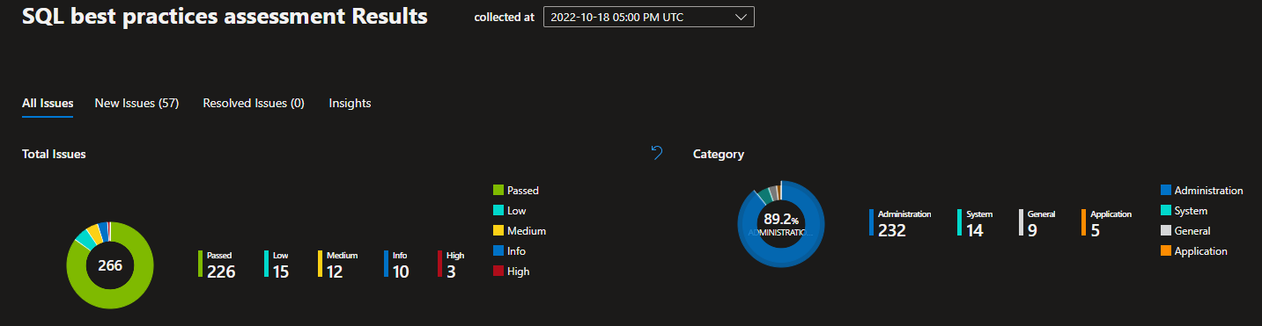
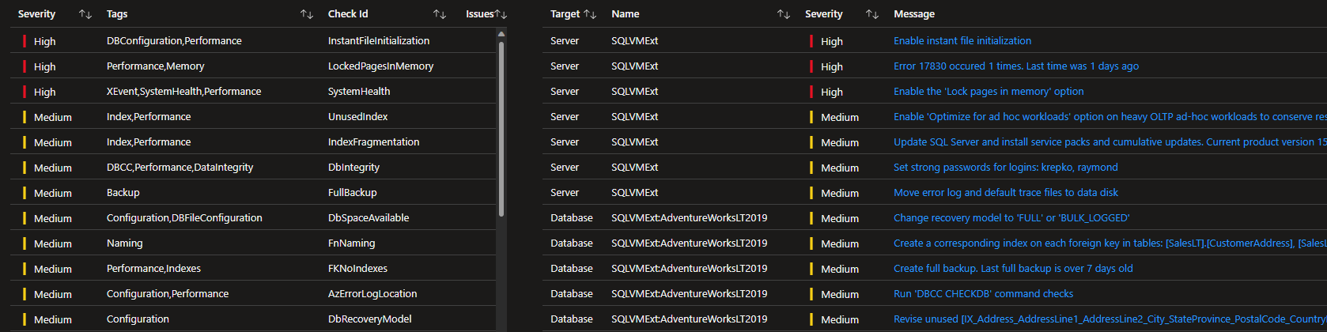
Automate SQL best practices assessment

Slide 4
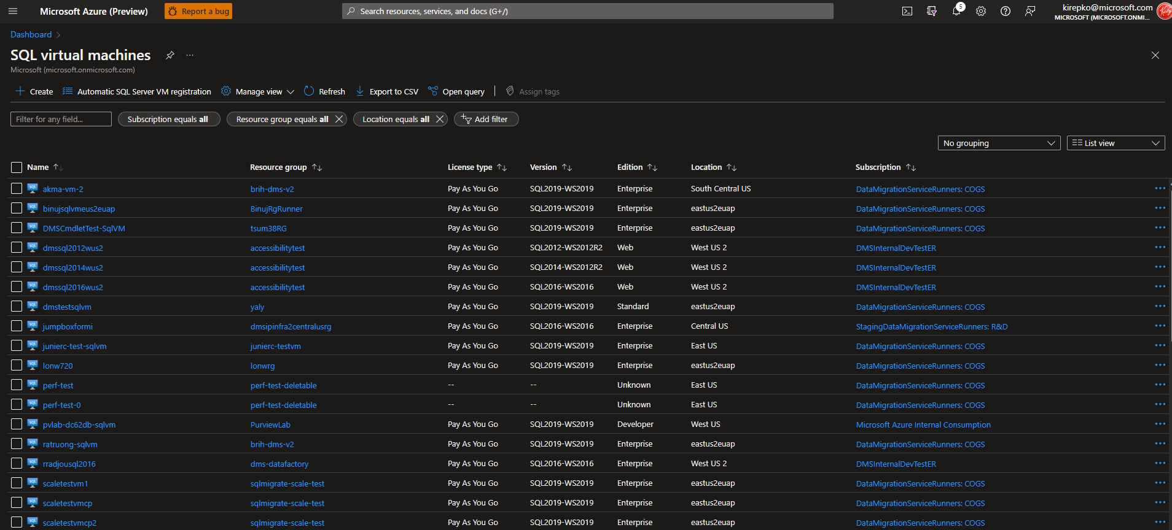
One view for all your SQL resources

Slide 5
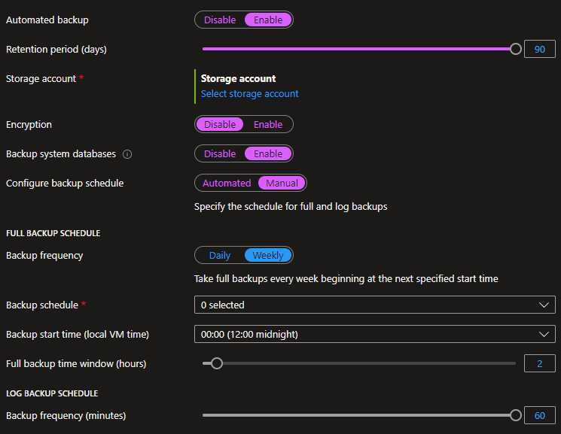
Automated Backups

Slide 6
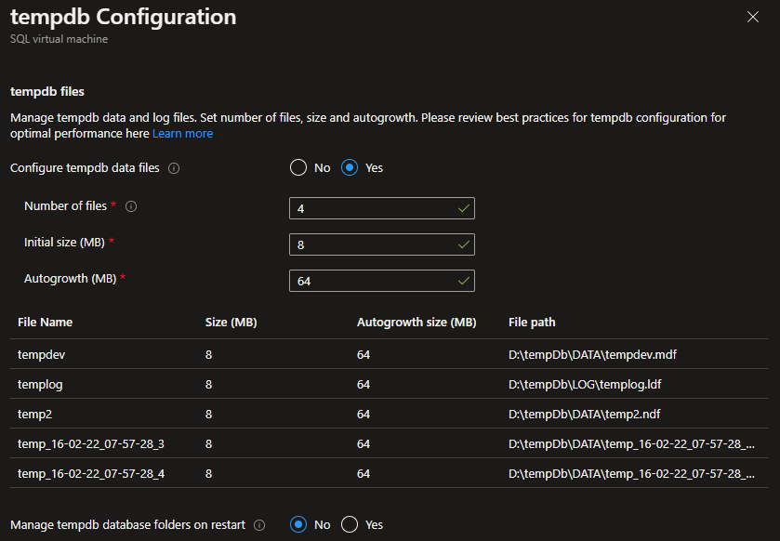
Easily configure TempDB and Disks from the portal

Slide 7
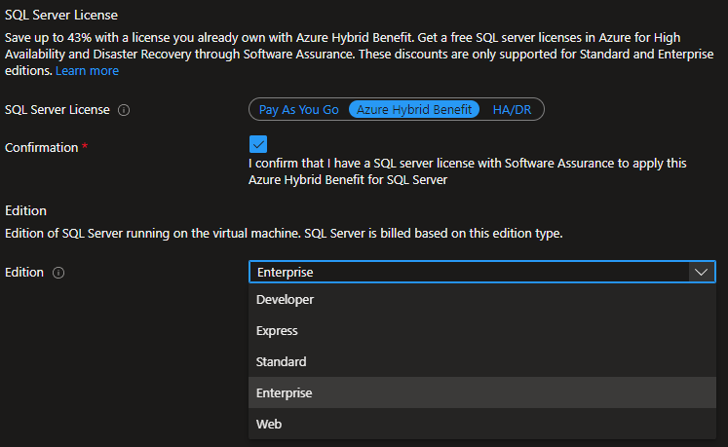
Change license types

Slide 8
Enhance Security

Slide 9
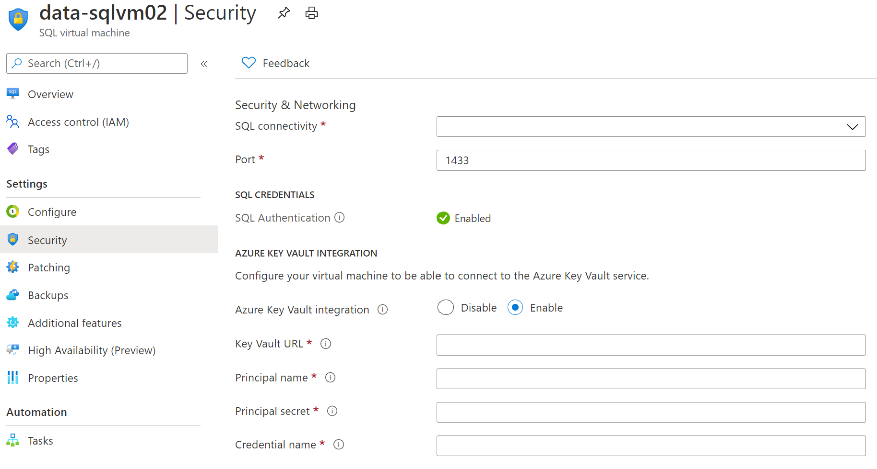
Azure SQL IaaS Extensions - Azure Key Vault Integration
Different SQL Server encryption features, such as transparent data encryption (TDE), column level encryption (CLE), and backup encryption, require you to manage and store the cryptographic keys you use for encryption.
The Azure Key Vault service is designed to improve the security and management of these keys in a secure and highly available location.
When this feature is enabled, it automatically installs the SQL Server Connector, configures the EKM provider to access Azure Key Vault, and creates the credential to allow you to access your vault.
Create a new key vault using New-AzKeyVault command. It will return vaultUri property, which is the key vault URL.
After key vault is created, add your keys to the key vault.
Steps:
Notes:
The SQL connectivity feature allows you to do the following:
Set the port for the SQL Server instance to ensure that you are able to listen on another port other than a well-known port.
Configure the connectivity rules to make it as restrictive like allowing local connectivity only or opening it up to public internet for external applications and clients to connect to the SQL Server instance (see screenshot below).
Enable SQL Authentication for the SQL Server instance if your applications and users require this authentication method.
Configure Azure Key Vault for the SQL Server instance to leverage Key Vault for Transparent Database Encryption, Column Level Encryption and Always Encrypted features of SQL Server to enable encryption of data at rest and in motion.

Slide 10
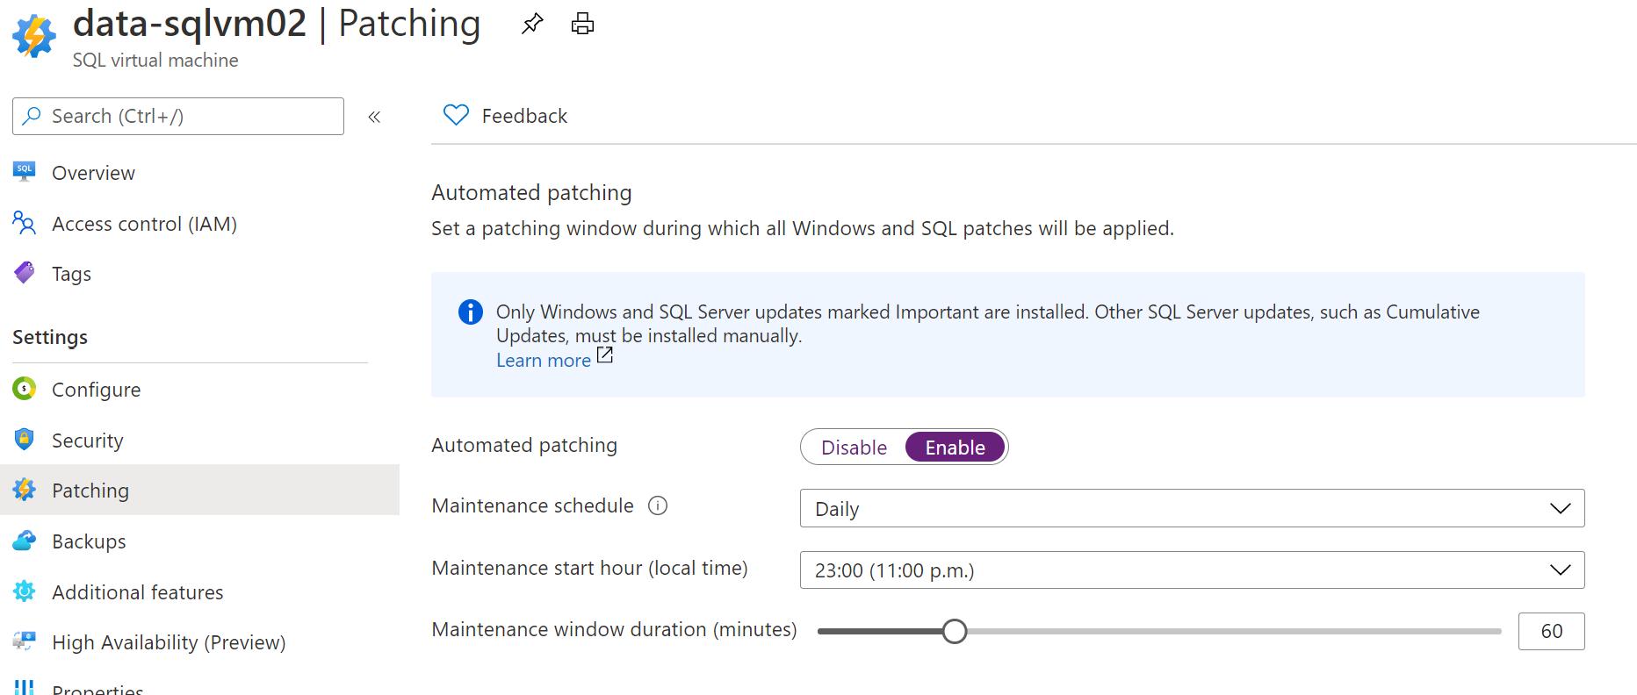
Azure SQL IaaS Extensions - Automated Patching Feature
The Automated Patching feature allows a SQL Server administrator to select a maintenance window schedule for applying Important Windows Server and SQL Server updates that are distributed through the Windows Update channel.
Notes:
Security is a key area of interest for any database administrator who is responsible for securing and protecting business data stored in a SQL Server database. Sometimes compliance requirements drive security needs like encryption of data at rest. SQL Server on Azure Virtual Machines make security management easier through patching and easily implement encryption features for better security and compliance.
Extended support for SQL Server 2008 and SQL Server 2008 R2 ended on July 10, 2019. Customers that have SQL Server 2008 R2 and SQL Server 2008 can upgrade to a newer version of SQL Server or migrate to Azure SQL Database or Managed Instance. There is also an option for customers to stay protected using Extended Security Updates for SQL Server 2008 or SQL Server 2008 R2. This is available for Free and enabled by default when migrating on-premises servers to SQL Server on Azure virtual machines. This provides you the ability to receive a critical security update when one is released or receive technical support for SQL Server 2008 or SQL Server 2008 R2 with your existing support plan without having to purchase Extended Security Update subscriptions.

Slide 11
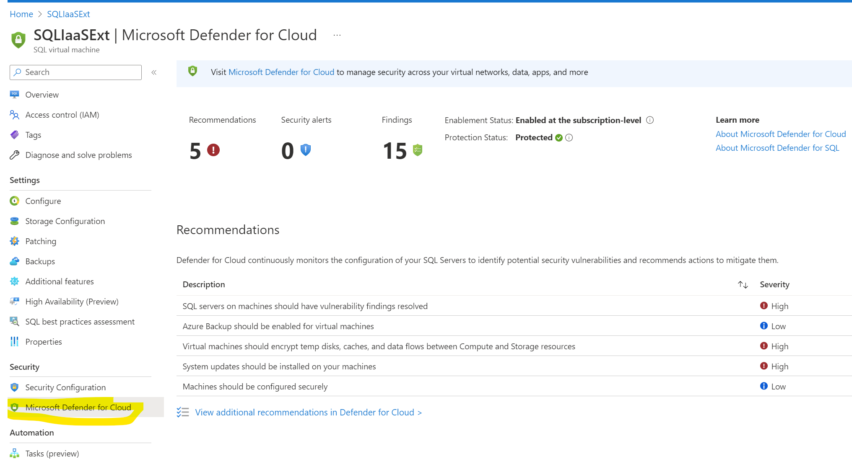
Get security recommendations right in your SQLVM blade
Notes:
In addition to the above benefits, SQL Server on Azure virtual machines also offer you the ability to
detect anomalous activities indicating unusual and potentially harmful attempts to access or exploit databases. You'll see alerts when there are suspicious database activities, potential vulnerabilities, or SQL injection attacks, and anomalous database access and query patterns.

Slide 12
Enabling these features

Slide 13
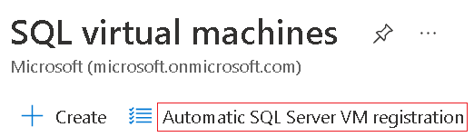
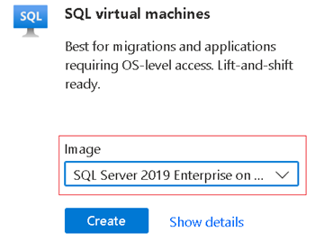
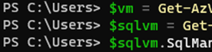
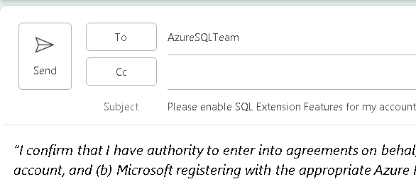
Enabling the features are easy
Click the button in Portal
One click can enable it for your subscription
Opt-in during your install of SQL Server
This is your “Error and Usage Reporting” screen
Select an Azure Image on creation
Features are turned on by default
Use the command line
PowerShell automates it, we provide the scripts
Ask us to do it for you!
We’ll provide an email template that you “sign”,
then we enable on the back-end

Slide 14
Email Template
Update the highlighted option and add your name.
Paste this text into an email and send to your account team.
In order to proceed with automatic registration of SQL Server instances running in Azure VMs for all Azure subscription IDs associated with the enrollment under which your organization obtained Azure services (i.e., your Enterprise Agreement), please respond to this email with the following paragraph to indicate your consent.
“I confirm that I have authority to enter into agreements on behalf of [INSERT CUSTOMER NAME]. On behalf of my organization, I consent to (a) Microsoft retrieving the list of Azure subscription IDs associated with my [ORGANIZATION or ENROLLMENT – pick 1 of 2 option] Azure account, and (b) Microsoft registering with the appropriate Azure Resource Provider all existing and future SQL Server instances installed on virtual machines, Linux containers or physical servers running in Azure or connected to Azure via Azure Arc in all subscription IDs associated with the agreement under which my organization obtained Azure services.”
Microsoft has a No Audit policy in support of this motion - SQL Server Privacy Supplement
With this consent, Microsoft will proceed with the registration of SQL Server instances running in Azure VMs for all Azure subscription IDs associated with the agreement under which your organization obtained Azure services (i.e., your Enterprise Agreement).
Microsoft will continue to add new benefits over time to provide the full range of manageability services that are available under the SQL IaaS Agent extension described here.
By providing consent for Microsoft to register your SQL Server VMs running on Azure on your behalf, you confirm that you have authority to enter into agreements on behalf of your organization, and you consent to allow Microsoft to access SQL Server environment information in all existing and future Azure VMs belonging to the subscription IDs associated with your organization’s Azure account.
Furthermore, you agree to permit Microsoft to register all SQL Server instances in the subscription IDs associated with your organization’s Azure account with the SQL VM Resource Provider as described here: https://docs.microsoft.com/en-us/azure/azure-sql/virtual-machines/windows/sql-vm-resource-provider-register?tabs=azure-cli%2Cbash

Slide 15
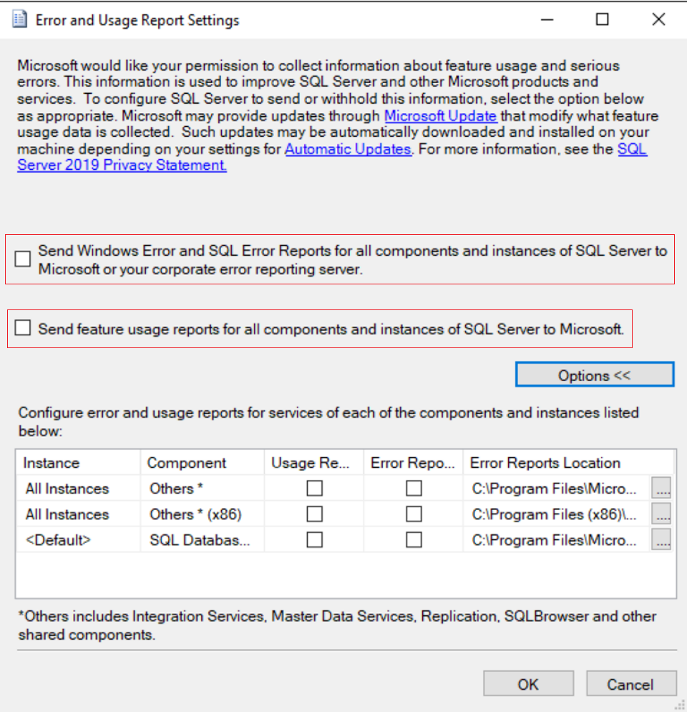
Enable during Install
Selecting the boxes below on your custom install of SQL Server enables these features.

Slide 16
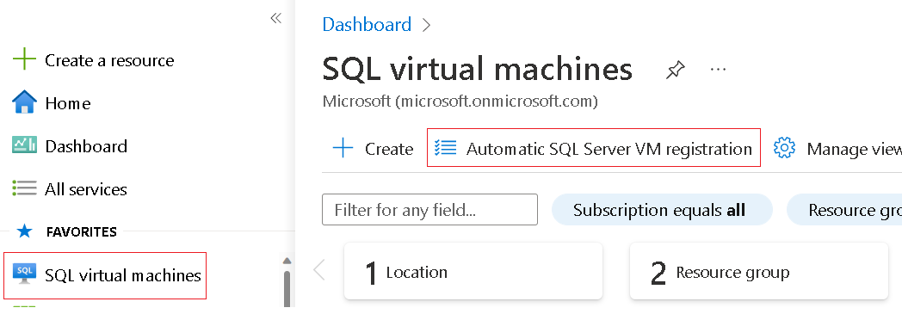
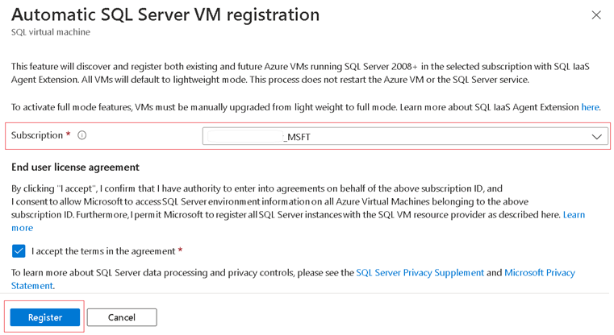
Click the button in Azure Portal
Simply click the
“Automatic SQL Server VM registration” button in the portal
It will be enabled for all your SQL Server Virtual Machines in Lightweight Mode.

Slide 17
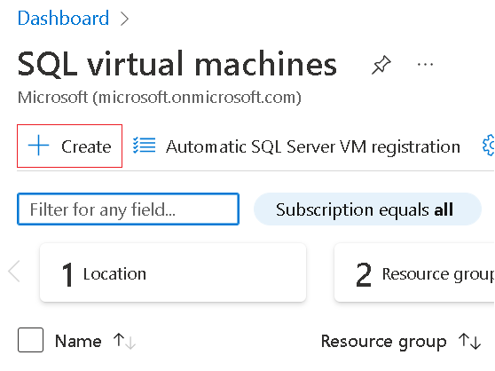
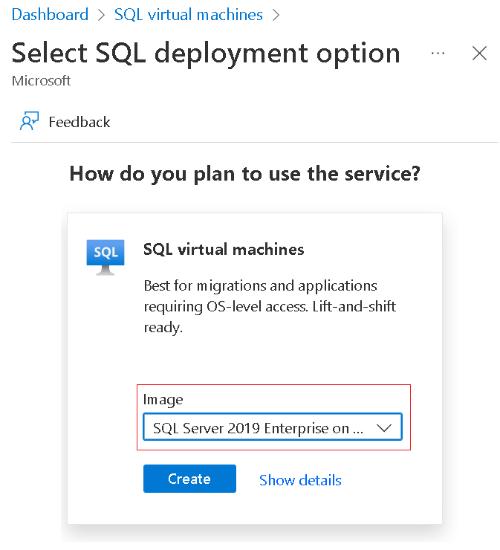
Select an Image in Azure
When creating your SQL Server Virtual Machine, select an image that is created and verified by Microsoft . The IaaS features will automatically be enabled.

Slide 18
Microsoft support and resources
Automatic registration with SQL IaaS Agent extension
Automate management with the SQL Server IaaS Agent extension
Register multiple SQL VMs in Azure with the SQL IaaS Agent extension
FAQ for Extensions
Product Group Postings on Azure SQL Server on VM including information about extensions
Product Group github with scripts

Slide 19
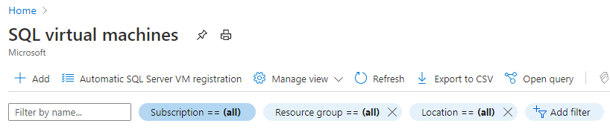
Bringing PaaS like features to Azure SQL VM
Features of SQL IaaS Extensions | Extensions not enabled | Extensions enabled
 |  | Lightweight mode | Full mode
Visibility to the SQL Server VM estate (editions, configuration state) via Portal Management
Visibility to the licensing of SQL Server instances (switch between PAYGO and AHB, included HA/DR license)
Unified Management View (SQL VM/PaaS deployments management in one location)
SQL Server integration with Azure Key Vault (Encryption keys storage)
Automatic configuration of Always On for High Availability (creation of availability group with CLI or UI)
Automated Patching (configuration PaaS like for installation of critical updates)
Automated Backup (configuration PaaS like with Point-in-Time Restore)
Disk Scaling and Utilization view (Resize Data and Log disks from Azure Portal)
If Azure Defender for SQL is enabled, Security Center recommendations are visible directly in SQL Virtual Machines resource view in Azure Portal
Automatic SQL Server VM registration button enables SQL IaaS Extensions features for all SQL VMs within a given subscription automatically.
In order to activate this feature for multiple subscriptions, the bulk action script is available.
Activation will require consent of the person who performs activation.
The request for customer consent enables to-customer statement in the opt-in that data can’t be used for audit unless the customer agrees: “Microsoft will not use this data for licensing audits without customer’s advance consent.”.
The SQL IaaS extensions will become active for all SQL Server VMs, and the features of lightweight mode will be activated within 24 hours after the activation.
Registering extension in full mode does not require restart of the server.

Slide 20
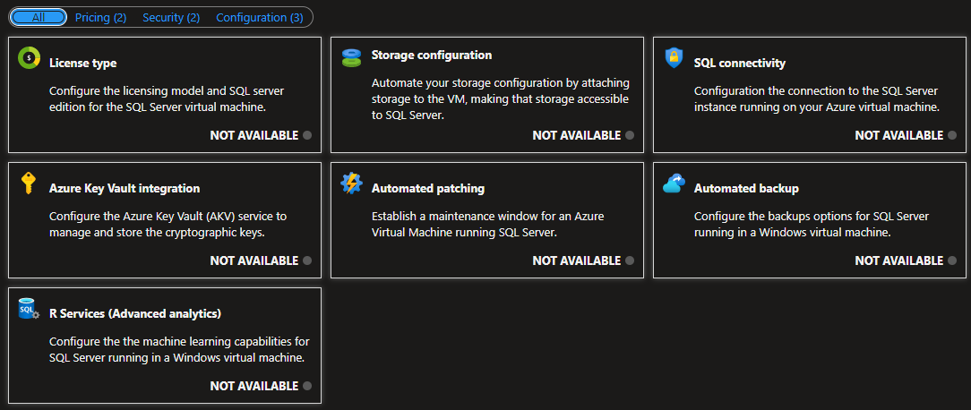
SQL IaaS features in one place

Slide 21
Azure SQL IaaS Extensions - management modes
Registering with the SQL Server IaaS Agent Extension automatically installs the SQL Server IaaS agent extension in one of three management modes, specified during the registration process. Not specifying the management mode will install the SQL IaaS agent extension in full management mode.
Lightweight
Does not require the restart of SQL Server
Supports only changing the license type and edition of SQL Server
Use this option for SQL Server VMs with multiple instances, or participating in a failover cluster instance (FCI)
No impact to memory or CPU
No associated cost
It is recommended to register your SQL Server VM in lightweight mode first, and then upgrade to Full mode during a scheduled maintenance window.
Full
Does not require the restart of SQL Server
Supports all functionality
Use it for managing a SQL Server VM with a single instance
Installs two windows services that have a minimal impact to memory and CPU
No associated cost
NoAgent
Dedicated only for SQL Server 2008 and SQL Server 2008 R2 installed on Windows Server 2008
No associated cost

Slide 22
SQL Server IaaS Extensions - Lightweight mode as first step
First step is to enable Lightweight mode only
Lightweight Mode (default): Enable consent for the DEV, QA and other environments to have better visibility. Validate: Observe the environments for the period of 2 weeks, at the same time review and validate scripts that can automate auto registration for bulk numbers. Identify candidate subscription for production enablement (still in the lightweight mode only). Enable lightweight in staging and production: Using script, enable auto registration on the list of given subscriptions. The enablement will take up to 24 hours to register all SQL instances. Address any issues. Reporting: Incorporate information about SQL Server licenses, editions for better visibility. Upon successful completion of the first step, your organization will immediately realize value of the SQL IaaS extensions by understating the real estate of SQL VMs, leveraging AHB benefits, ability to access SQL configuration management in a consistent PaaS like way. As your organization will complete enablement of the lightweight mode across all subscriptions, the planning and implementation of the second phase “Full Mode” could be taking place. Moving from lightweight mode to full mode will require manual or scripted enablement of the Full Mode for each of the registered SQL server VM instance. Registering extension in full mode does not require SQL server restart.
Azure SQL IaaS Extensions - single and bulk registration
There are multiple additional options how SQL Azure VM Extensions could be registered. Automatic registration for multiple subscriptions could be done by leveraging PowerShell script (provided) Single VM registration is also available via Azure Portal or Azure CLI/PowerShell If it is required to reinstall or unregister extension, it could be done via Azure Portal or Azure CLI/Azure PowerShell scripts for a single VM or bulk

